Slide 1
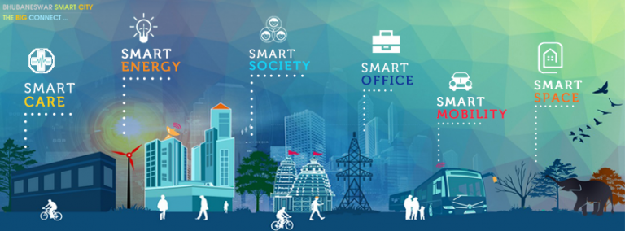
SMART CITY

Slide 2
THE TEAM
SPARSH AGRAWAL (13MT10035)
RAHUL AGARWAL (13NA10022)
SANKET VARADE (13NA10028)
PUNIT PAL (13NA30013)
SWATI SAGAR (13NA30023)

Slide 3
WHAT IS A SMART CITY?
A smart city is an urban development vision to integrate multiple information and communication technology (ICT) solutions in a secure fashion to manage a city’s assets – the city’s assets include, but not limited to, local departments information systems, schools, libraries, transportation systems, hospitals, power plants, water supply networks, waste management, law enforcement, and other community services.
The goal of building a smart city is to improve quality of life by using technology to improve the efficiency of services and meet residents’ needs.
ICT is used to enhance quality, performance and interactivity of urban services, to reduce costs and resource consumption and to improve contact between citizens and government.[3] Smart city applications are developed with the goal of improving the management of urban flows and allowing for real time responses to challenges.

Slide 4
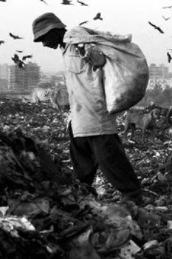
Garbage Disposal in India
62 million tonnes of garbage is generated everyday by the 377 million people living in urban India, now the world’s third-largest garbage generator.
With rapid urbanisation, industrialisation and an explosion in population in India, solid waste management will be a key challenge for state governments and local municipal bodies in the 21st century.
As per a 2013 report from the International Solid Waste Association (ISWA) Low-income countries like INDIA have low collection rates of around 41% while high-income countries have higher collection rates averaging 98%.

Slide 5
PRESENT SYSTEM IN PLACE
The current state of garbage disposal, collection and treatment is very bad; Leading to littering of streets and injudicious use of municipality resources.
In an average locality, we find that there are inadequate amount of dustbins placed at random locations kept at illogical places.
The collection process involves a certain amount of trucks which come at a random time of the week and empty some bins which fall on their route.
This leads to a constant overflow of garbage near the bins leading to a unhygienic environment in the locality.
The resources required to run the trucks also are not optimised which leads to wastage of diesel and manpower without covering every garbage pickup point.

Slide 6
OUR SOLUTION

Slide 7
What we Propose?
There are three stages in our solution.
Stage One - Creation and installation of smart dustbins across the cities which will have ultrasonic sensors installed.
These sensors will provide us the current volume filled of the dustbin to a remote main system installed at the Municipal Corporation.
Stage Two - A central control system which receives the volume percentage filled data from various smart dustbins at real time.
It saves these data and also calculates the instantaneous rates at which these garbage bins are getting filled.
Stage Three - A route guidance system which will be provided to every garbage truck driver so as to optimise the path that they follow during their collection exercise.

Slide 8

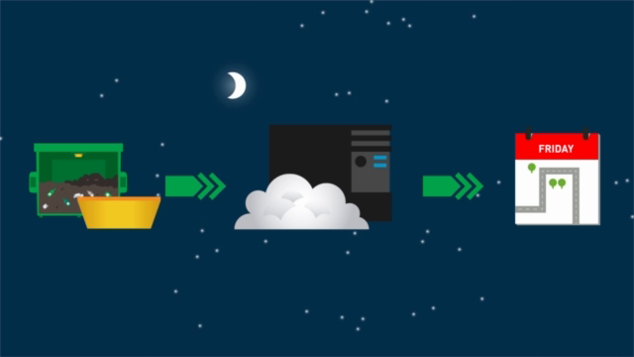

Slide 9
Part - 1 (Fuzzy Logic)
For this model, we have assumed that the layout of the bin in our city is in the form of a n x n matrix.
The said dustbins are located inside each cells of this n x n matrix.
We take two input values, namely Volume percentage (where 0<V<1) and Filling rate (where 0<R<1) for each of our decided dustbin and put it through an Inference System in MATLAB.
This gives us an output matrix of same n x n size with each value ranging from 0 to 1 based on pre-decided fuzzy rules.

Slide 10
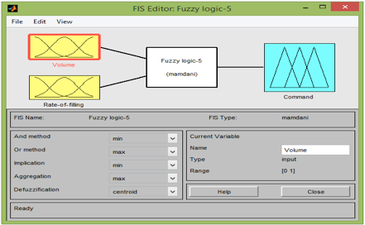
Output of command were found on the basis of two input variables which are Volume and Rate of filling of the dustbins in our locality using fuzzy logic

Slide 11
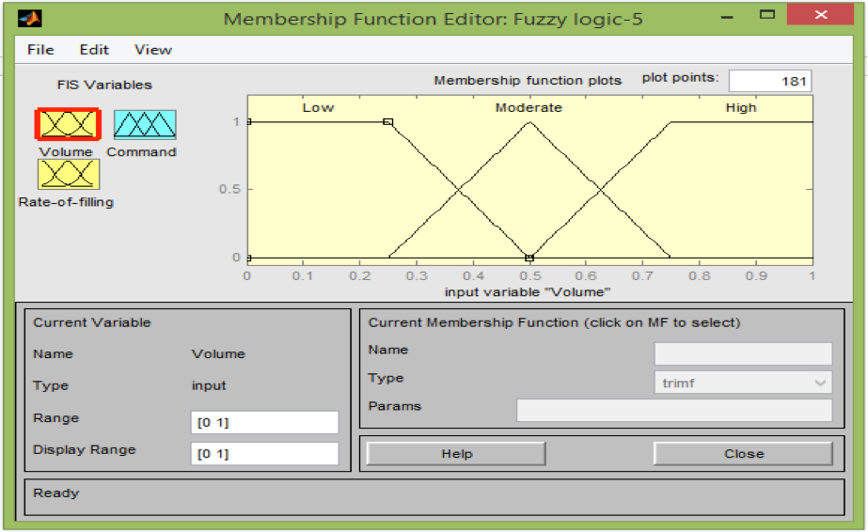
Distributions of volumes of dustbins – Low, Moderate and High.

Slide 12
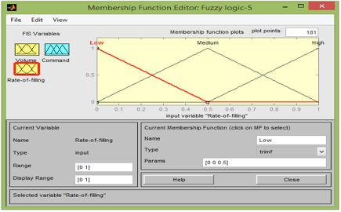
Distributions of Rate of Filling of the dustbins – Low, Moderate and High

Slide 13
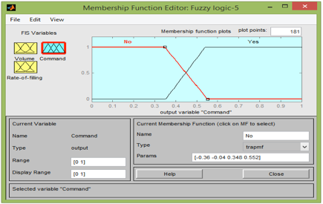
The output command decisions of whether the truck should go or not are taken on the basis of some rules.

Slide 14
The Rules
The rules are -
If the volume of the dustbin is Low and rate of filling is Low, then NO. If the volume of the dustbin is Low and rate of filling is Moderate, then NO. If the volume of the dustbin is Low and rate of filling is High, then NO. If the volume of the dustbin is Moderate and rate of filling is Low, then NO. If the volume of the dustbin is Moderate and rate of filling is Moderate, then YES. If the volume of the dustbin is Moderate and rate of filling is High, then YES. If the volume of the dustbin is High and rate of filling is Low, then YES. If the volume of the dustbin is High and rate of filling is Moderate, then YES. If the volume of the dustbin is High and rate of filling is High, then YES.

Slide 15
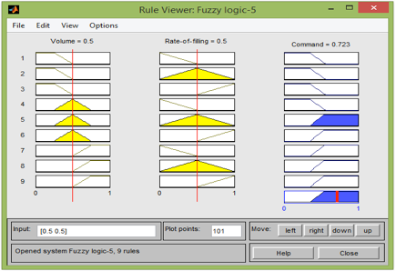
The Rules

Slide 16
Part 2 - Genetic Algorithm
This helps us to find the optimal solution by setting up a genetic algorithm to search for the shortest route.
A single truck travel to each of the garbage bin and completes the route by returning to the starting point.
Each garbage bin is visited by the truck exactly once.
This helps us save money, manual labour and diesel.

Slide 17
Algorithm
The co-ordinates of the garbage bins which are selected by the fuzzy inference system for garbage collection are stored in a 2D matrix.
Now, this matrix is used as an input argument for the genetic algorithm.
Idea of the Algorithm.

Slide 18
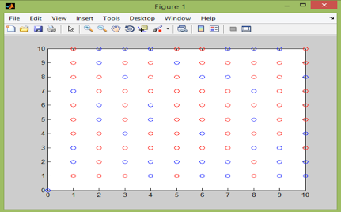
Here as stated, we can see the n x n matrix placement of all the dustbins.
The red dustbin indicates those which needs to get emptied according to the fuzzy rules specified and the blue dustbins are those which are empty or nearly empty.

Slide 19
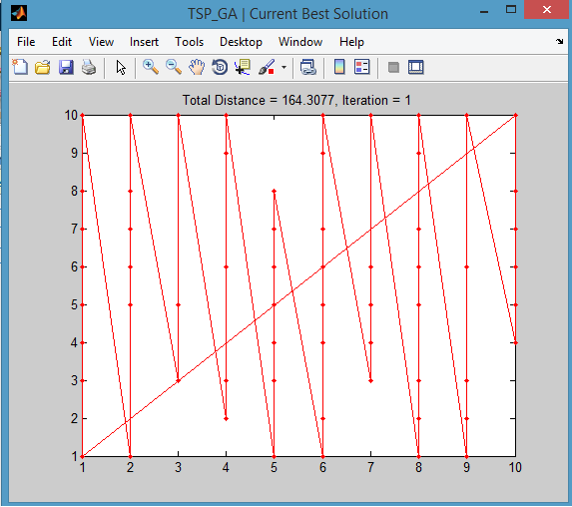
1st Iteration is simply the best route among the n x n routes calculated by the code!

Slide 20
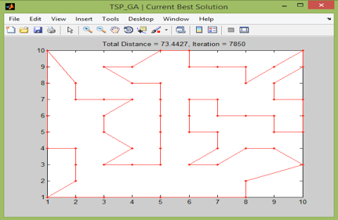
By using Genetic Algorithm, we have found out the most optimum path that a truck driver should take in order to cover all the filled up dustbins
(1,1) is the origin of travel

Slide 21
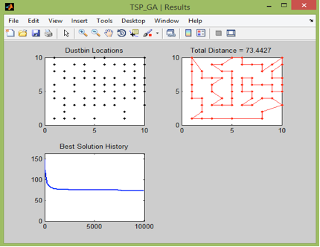
Combination of graphs showing results of our Genetic Algorithm
The last graph shows our solution getting better and better with each iteration.

Slide 22
DEMO

Slide 23

Work Flow
DATA
1- Volume
2- Filling Rate
Fuzzy
Inference
System
Identification of
Filled and Empty
Dustbins
Application of
Genetic Algorithm
Optimised
Path

Slide 24
Conclusion
This project has helped us understand more about the actual meaning of a SMART CITY.
We have worked upon the problem of waste disposal and waste collection and have optimised the process using our knowledge of fuzzy logic and genetic algorithm.
We believe that this model can be replicated in our real society to a bigger extent, saving us resources like diesel, manual work and amount of trucks while making our locality more cleaner and sanitised.

Slide 25
References
http://www.mathworks.com/matlabcentral/fileexchange/13680-traveling-salesman-problem-genetic-algorithm
Wikipedia
Getty Images
http://in.mathworks.com/help/gads/genetic-algorithm.html?requestedDomain=www.mathworks.com

Slide 26
“Thank You”
– Anonymous

